Slide 1
Mathematical Modeling of Hashimoto’s Thyroiditis

Slide 2

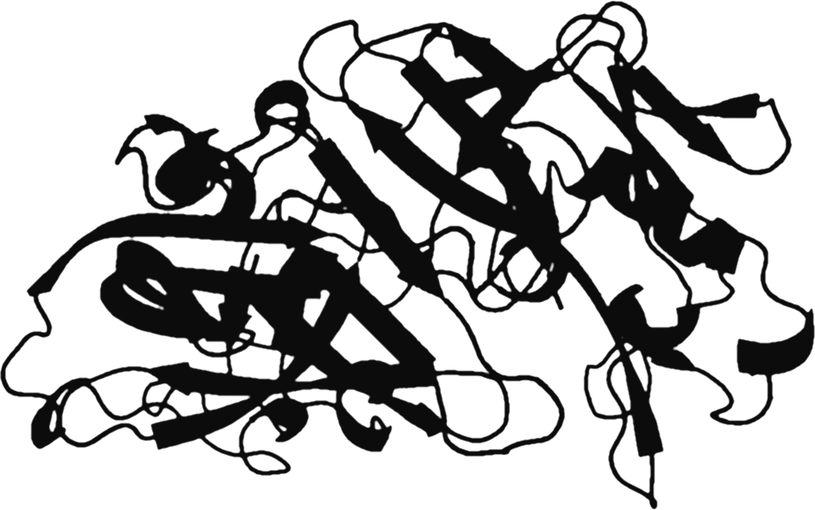
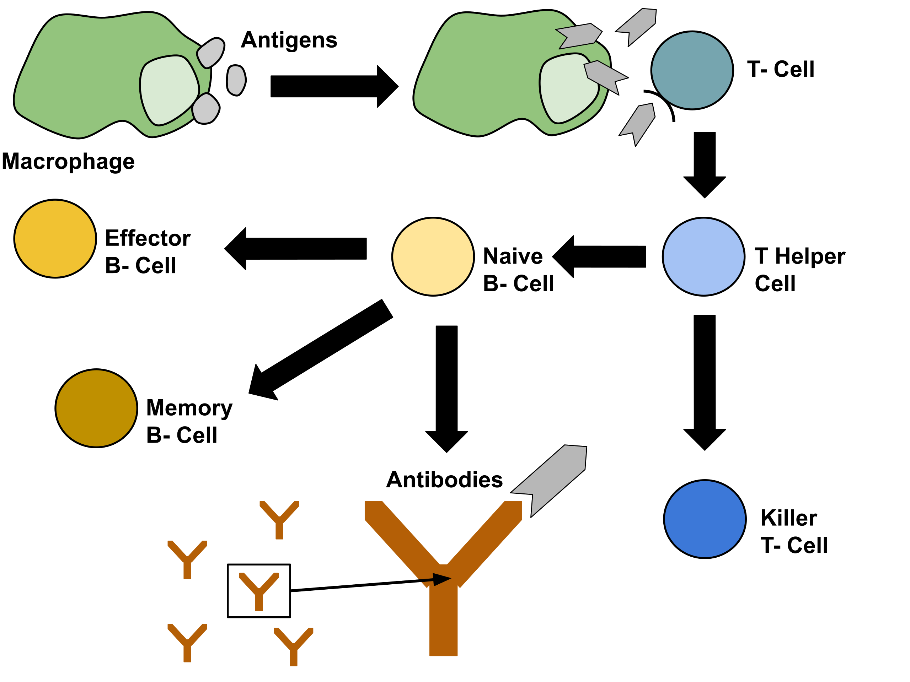

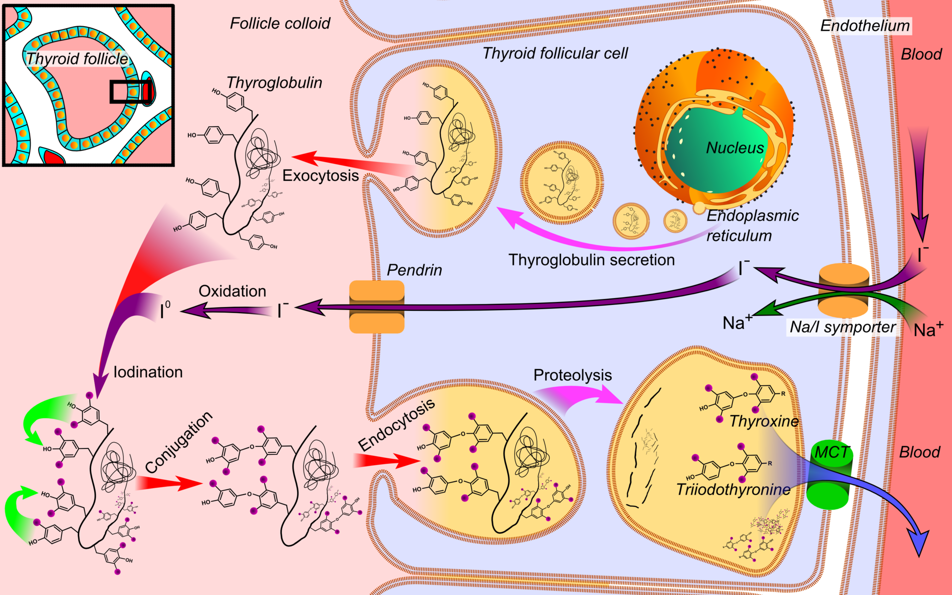
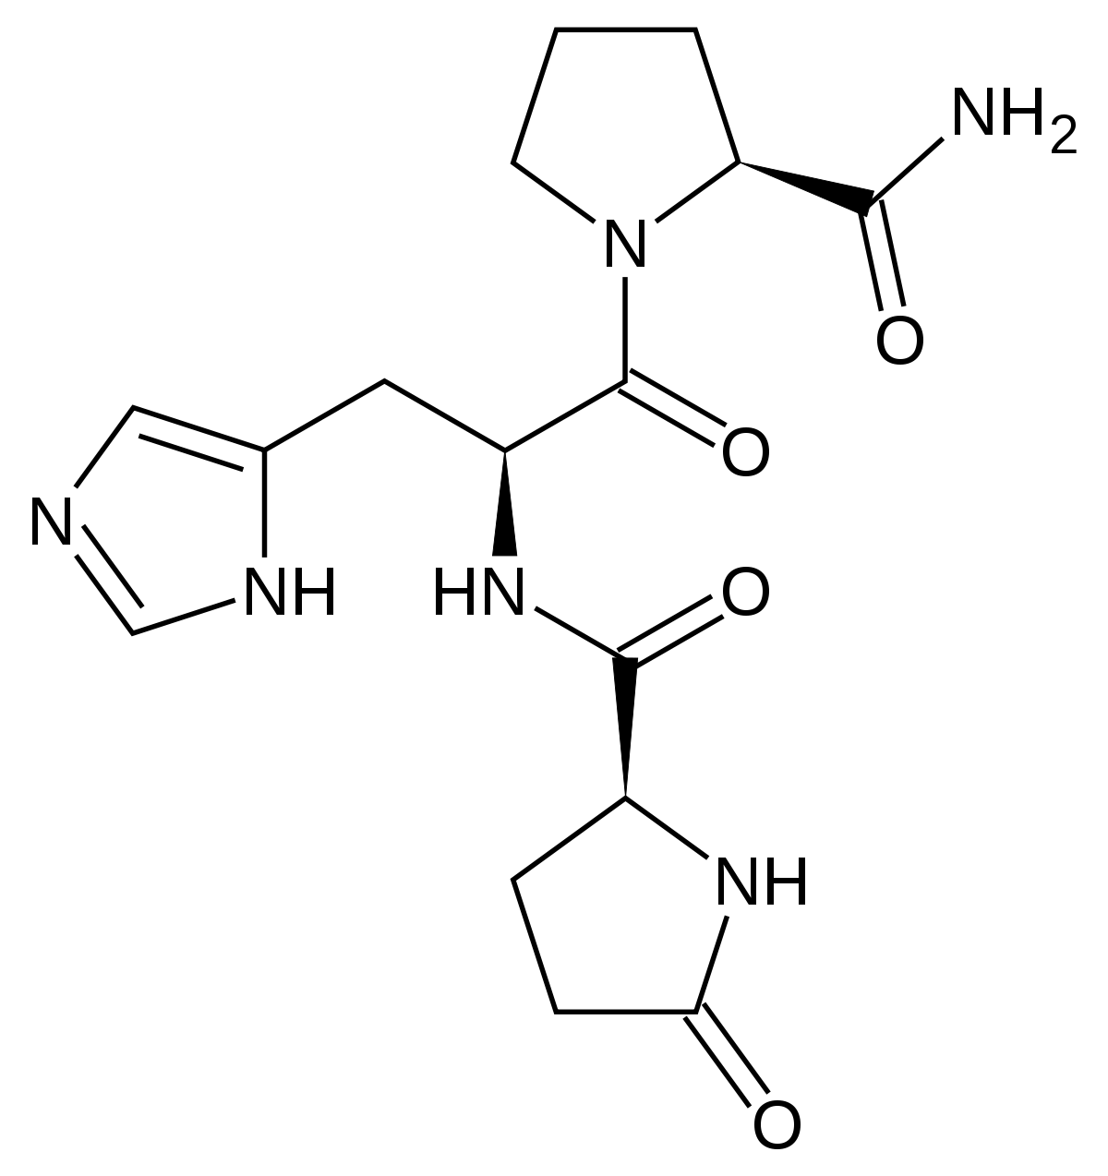
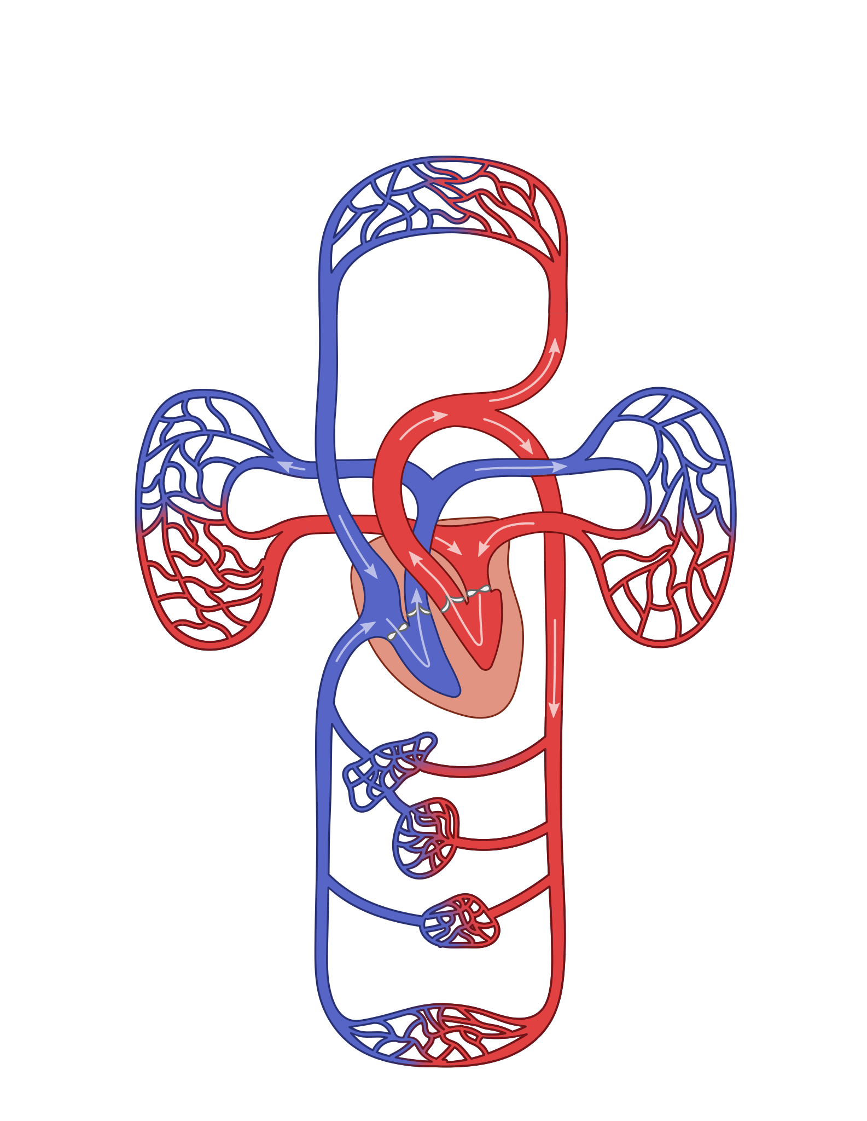
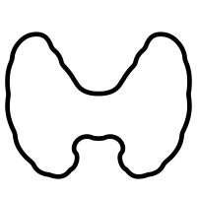

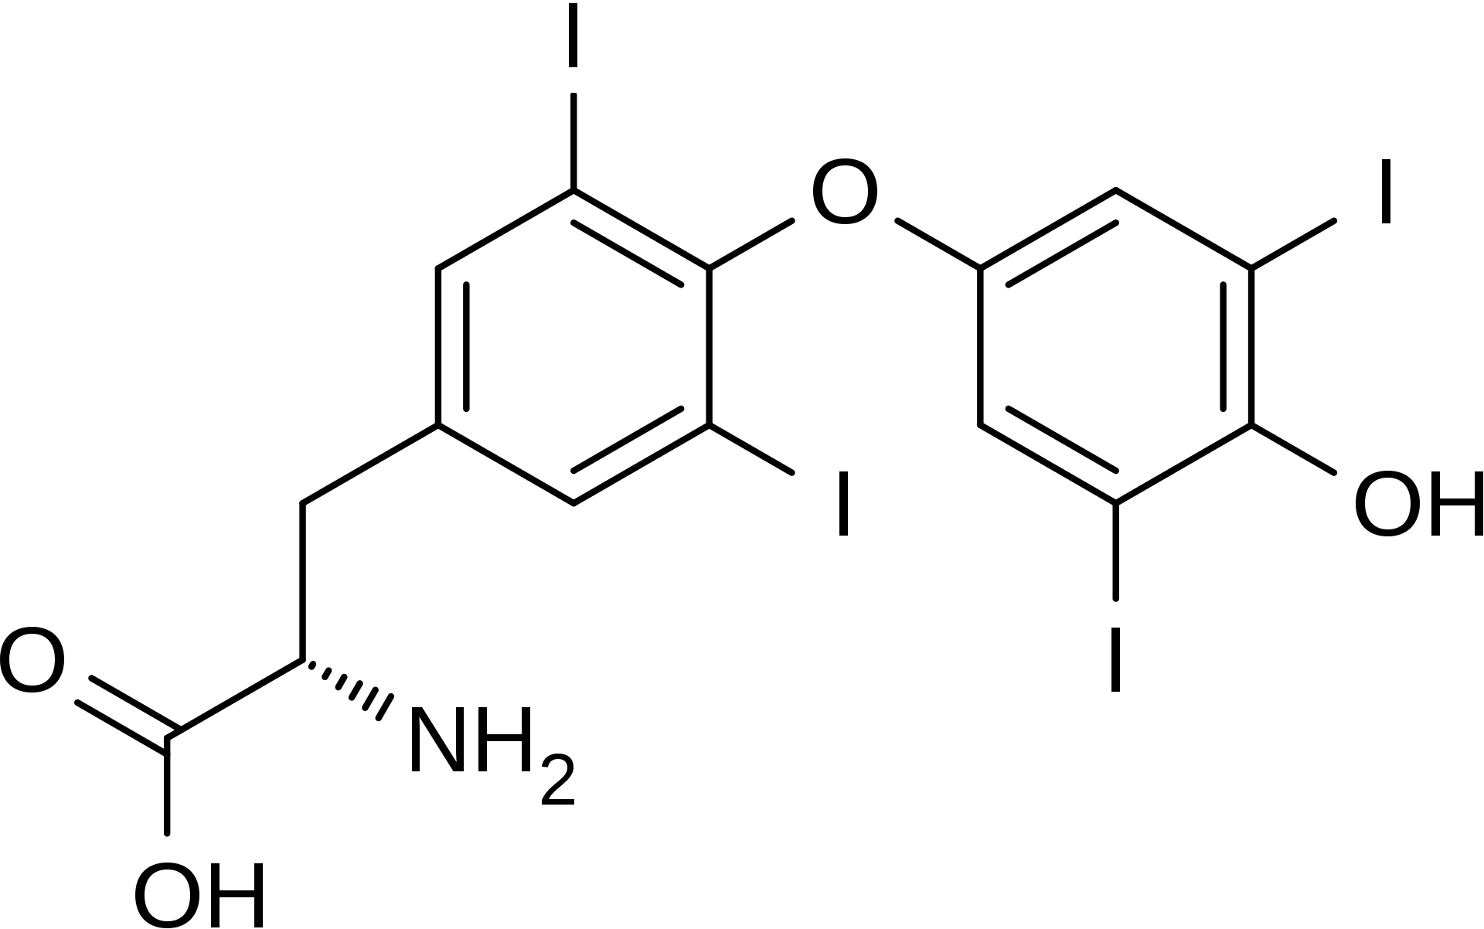
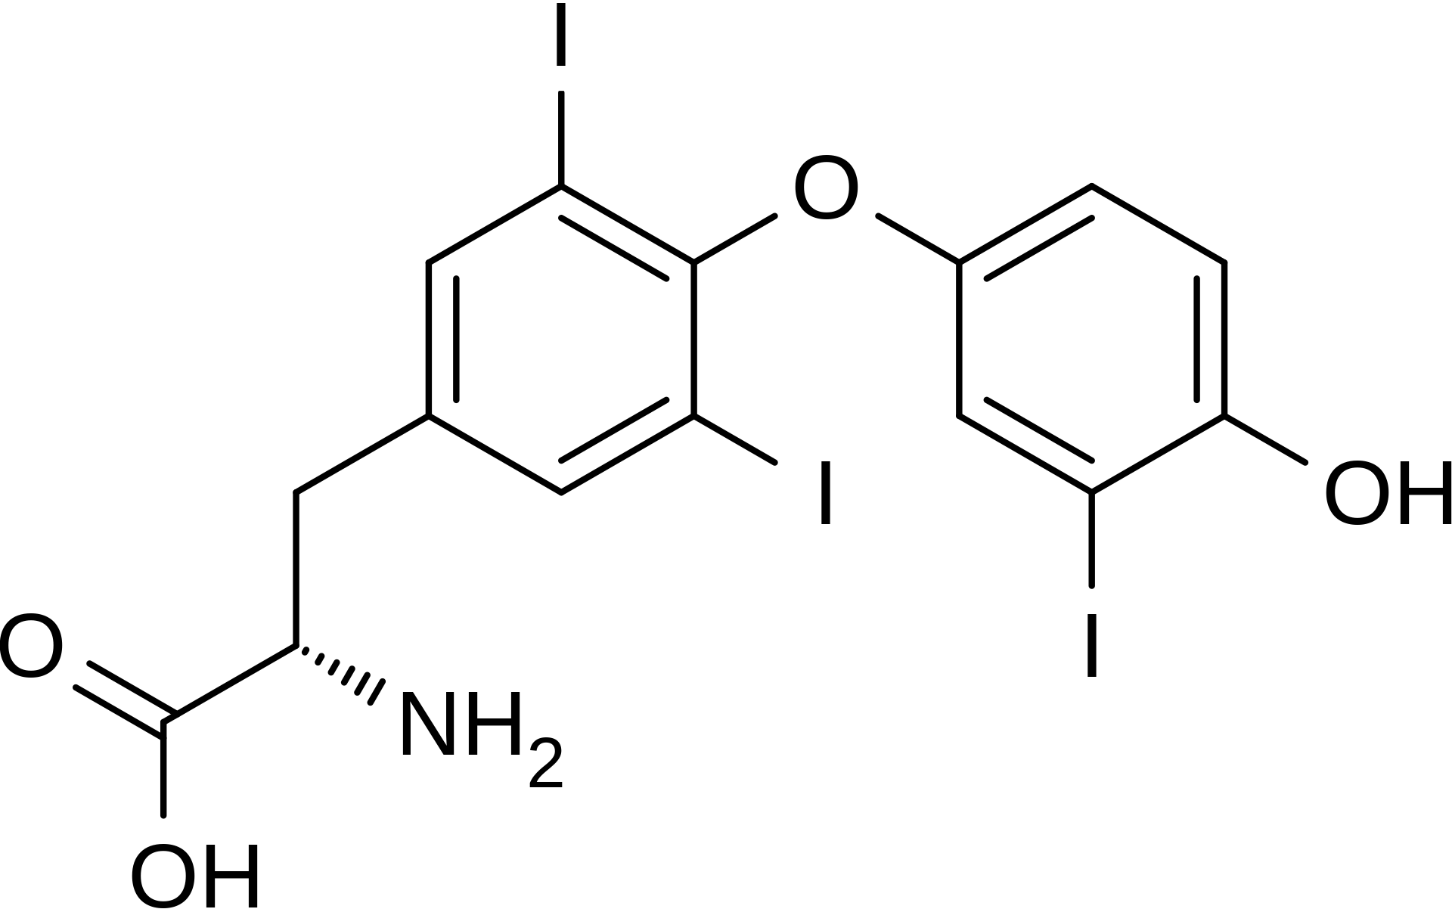
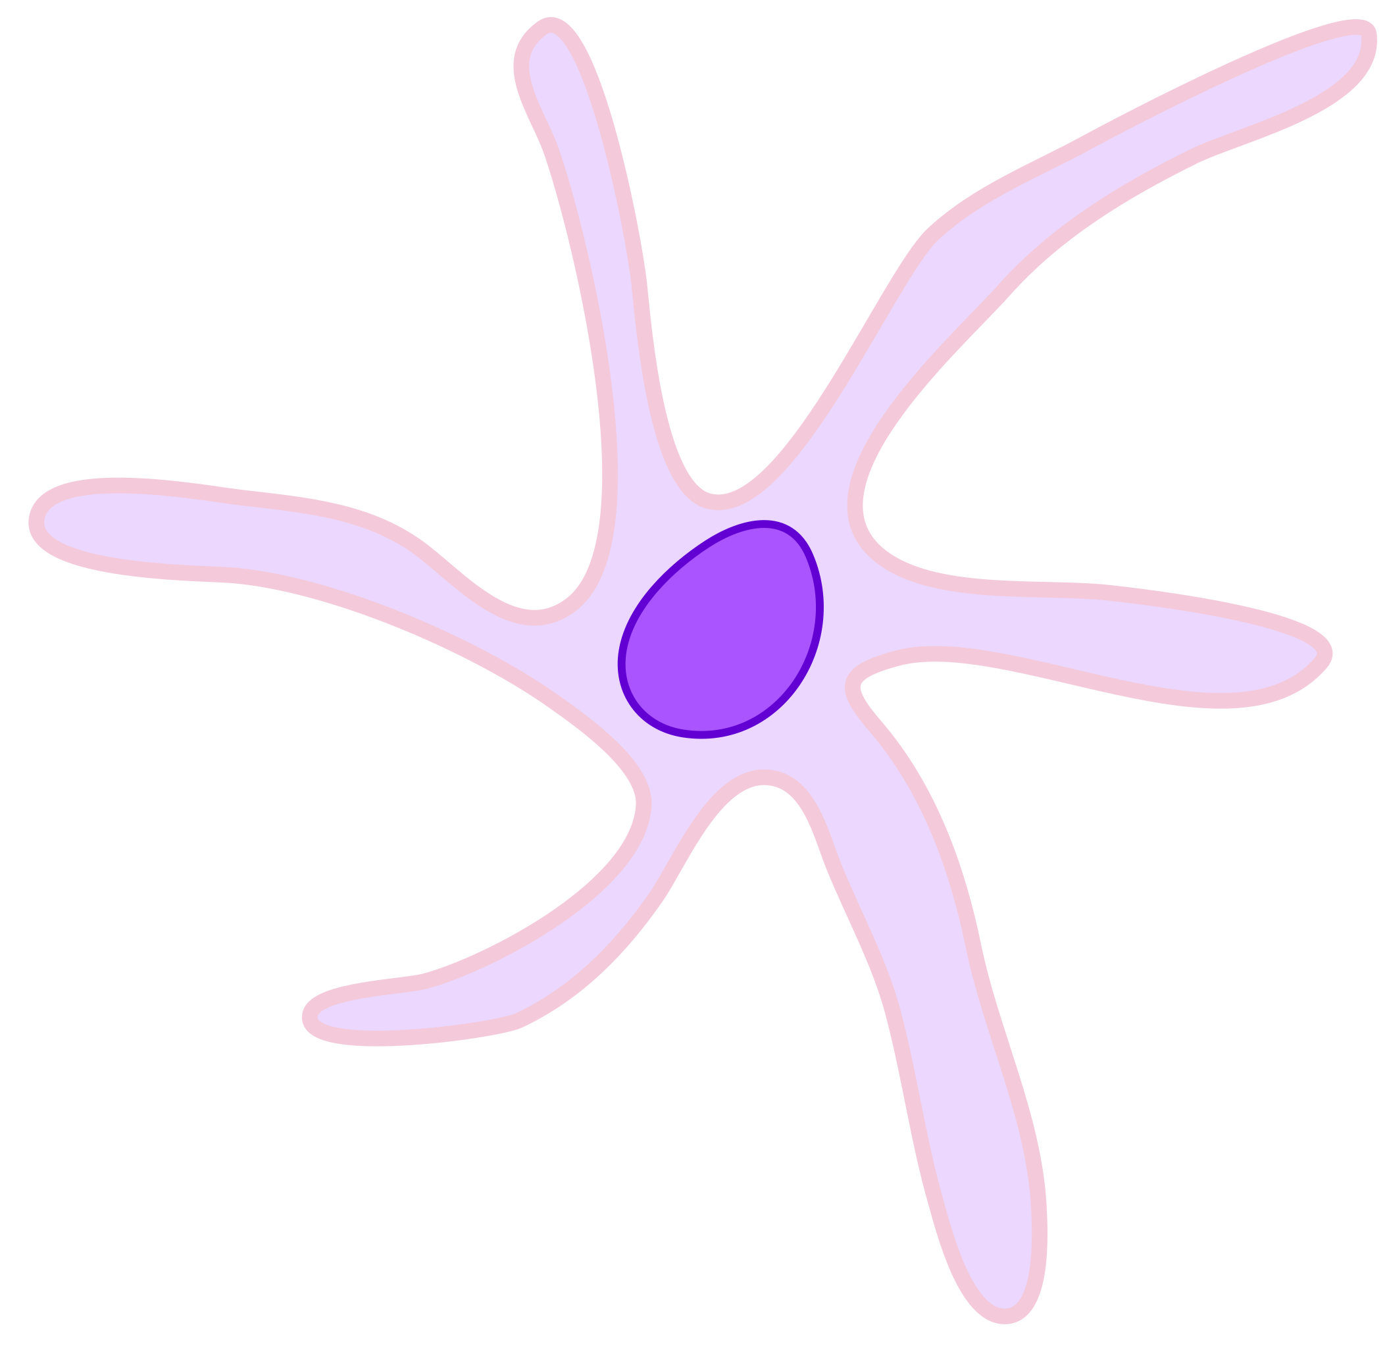
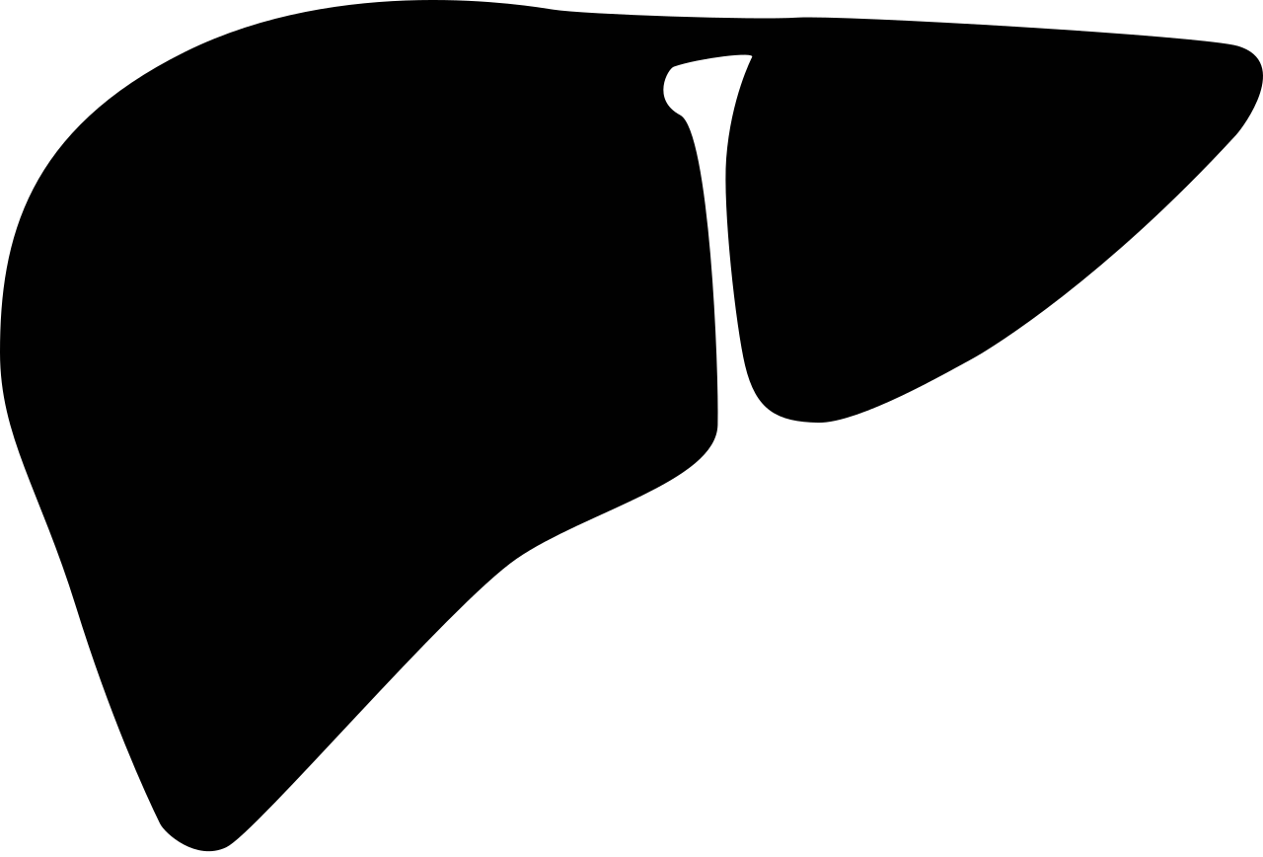
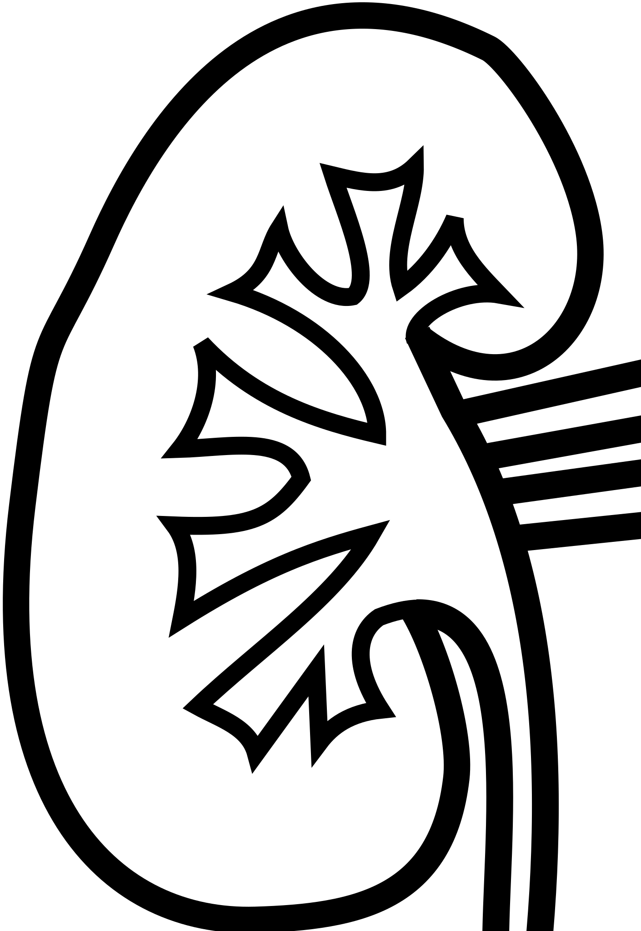


T3
B-Cell
(Plasma Cell)
Hide Ab Mechanism of Action
CD8+ T-cell
TRH
TGAb
Hypothalamus
Deiodinases
Pituitary
T4
T4
TG
Perforin, Granzymes
T3
TPOAb
TPO
TSH
[3]
T3, T4
TSH
T3
TGF-$β$
IL-10,35
Thyroid
IL-21,4
T4
IL-4,13
T4
Deiodinases
T3
IL-9,10
Treg
Tfh
Thyroid Antigen
(thought to be presented in exosome)
Slow
T4
Th2
T3
TLR2/3
IL-21,22,26
Th9
T4
Dendritic Cell
T3
T3
Th17
IL-22
TNF-a
Deiodinases
CD4+ T-Cell^{[1]}
Differentiation
LUMP CD4+, Cytokines, Chemokines
Fast
T4
Th22
IFN-$γ$
Th1
Notes:
Add slide with destruction of thyroid → resulting dynamics via T3/4 TSH graphs
Distinguish stimulatory/inhibitory cytokines
Dendritic cytokines?
CD8+ go into cell diagram (perforins and granzyme MOA)
Thyroid in fast compartment
Morph slides to show compartmentalization process
Separate (duplicate) set of slides with superscript references

Slide 3
T3
TRH
Deiodinases
Hypothalamus
Pituitary
T4
Slow
T4
CD8+ T-cell
T3
TGAb
TSH
Perforin, Granzymes
B-Cell
(Plasma Cell)
TSH
T3
TPOAb
Thyroid
T4
Stimulatory Cytokines
T4
T3
Deiodinases
Slow
T4
T3
T4
Dendritic Cell
T3
T3
Inhibitory
Cytokines
Deiodinases
CD4+ Cells
Fast
T4
Notes:
Add some sort of connection between the

Slide 4
T3
TRH
Deiodinases
Hypothalamus
Pituitary
T4
Slow
T4
CD8+ T-cell
T3
TGAb
TSH
Perforin, Granzymes
B-Cell
(Plasma Cell)
TSH
T3
TPOAb
Thyroid
T4
Stimulatory Cytokines
T4
T3
Deiodinases
Slow
T4
T3
T4
Dendritic Cell
T3
T3
Inhibitory
Cytokines
Deiodinases
CD4+ Cells
Fast
T4
Notes:
Add some sort of connection between the

Slide 5
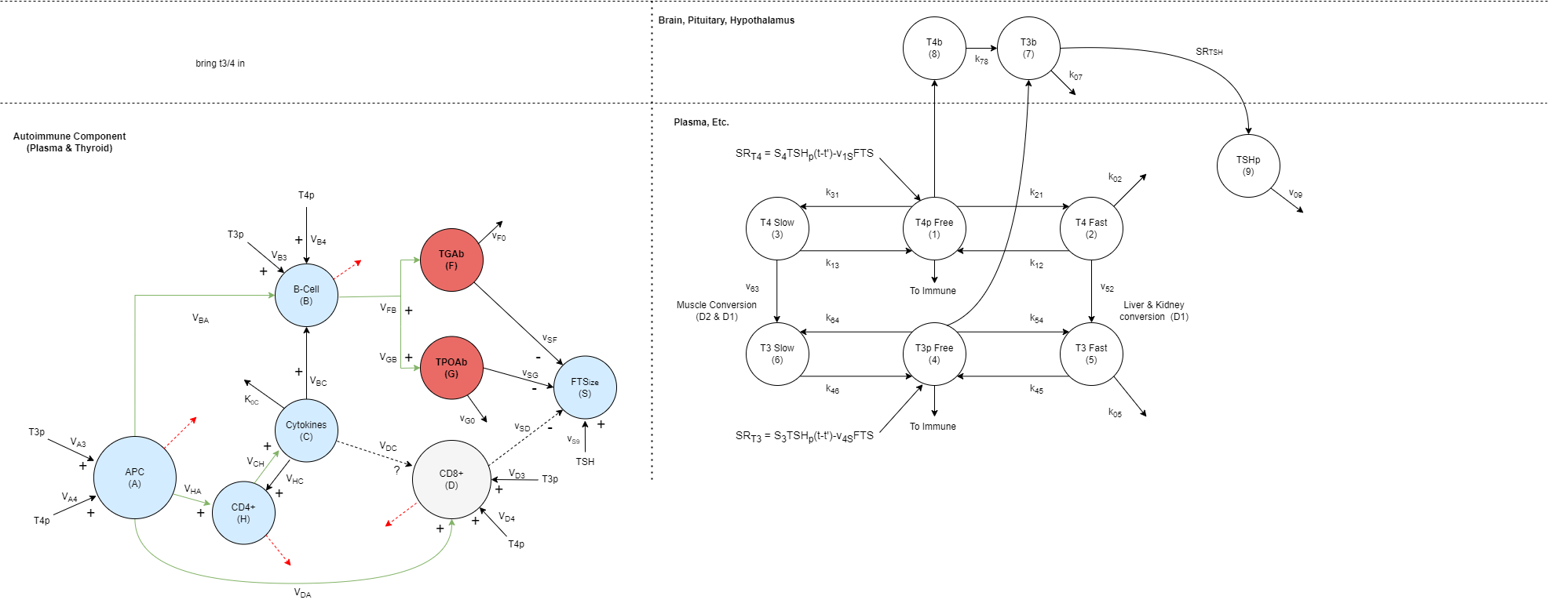
Same Immune subsystem, new notation
CD8+ T-cell
TGAb
Perforin, Granzymes
Formalize with Control Notation
B-Cell
(Plasma Cell)
TPOAb
Thyroid (FTS_{ize})
Cytokines
Dendritic Cell (APC)
Degradation terms made explicit via “leaks”
CD4+ Cells

Slide 6
Same Immune subsystem, new notation

Slide 7
T3
TRH
Deiodinases
Hypothalamus
Pituitary
T4
T4
CD8+ T-cell
T3
TGAb
TSH
Perforin, Granzymes
B-Cell
(Plasma Cell)
TSH
T3
TPOAb
Thyroid
T4
T4
T3
Deiodinases
Slow
T4
T3
Cytokines
T4
Dendritic Cell
T3
T3
Deiodinases
CD4+ Cells
Fast
T4

Slide 8
Similar process for TH subsystem
T3
TRH
Deiodinases
Hypothalamus
Pituitary
T4
T4
T3
TSH
TSH
Formalize with Control Notation
T3
Thyroid
T4
T4
T3
Deiodinases
T3
Slow
T4
T4
T3
T3
Deiodinases
Fast
T4

Slide 9
Similar process for TH subsystem
Solve system of ODEs and algebraic equations numerically
Predict unmeasurable compartments (e.g. T3 Fast)

Slide 10
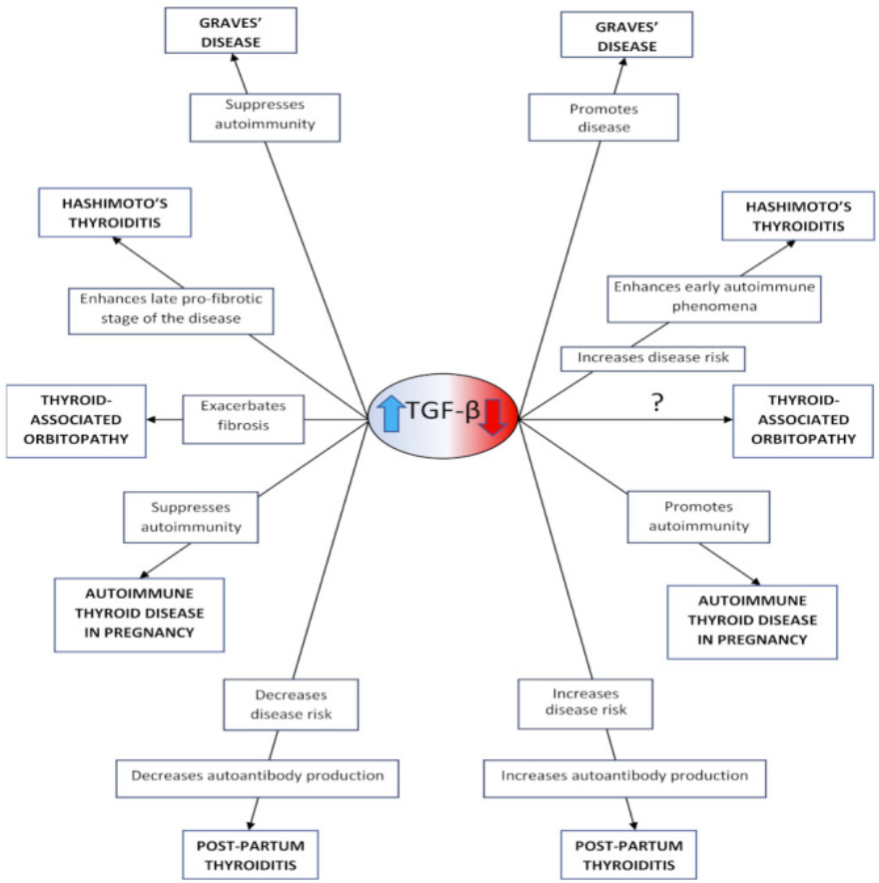
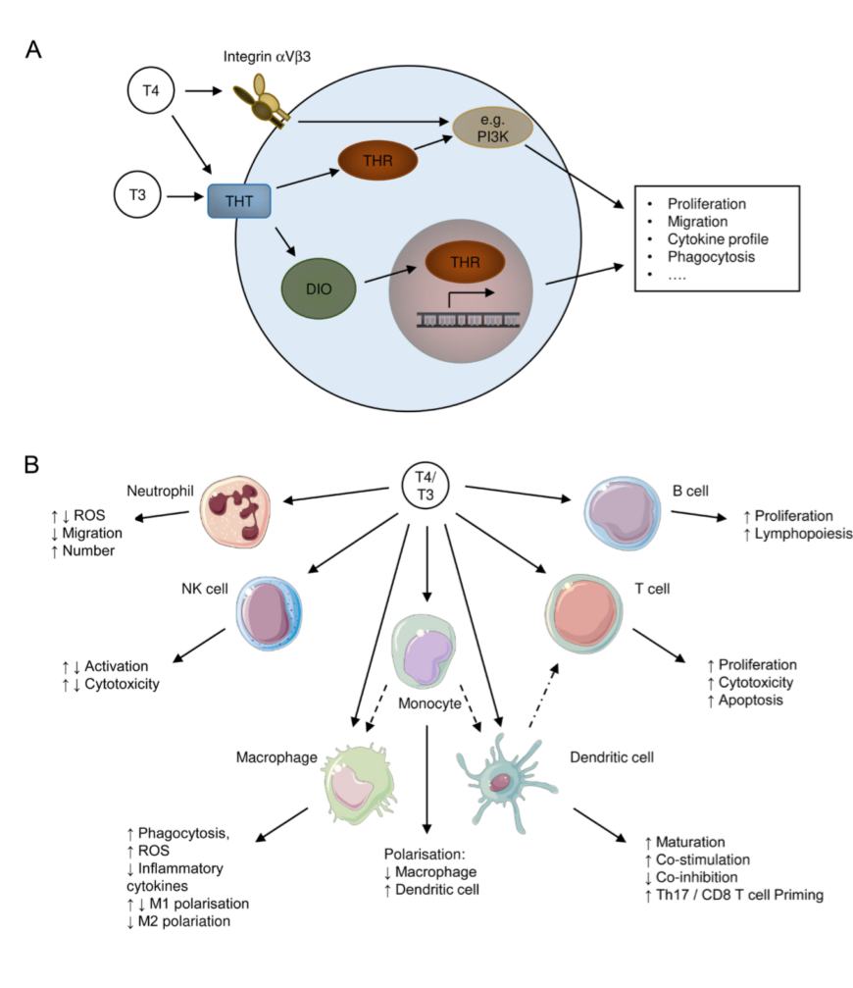
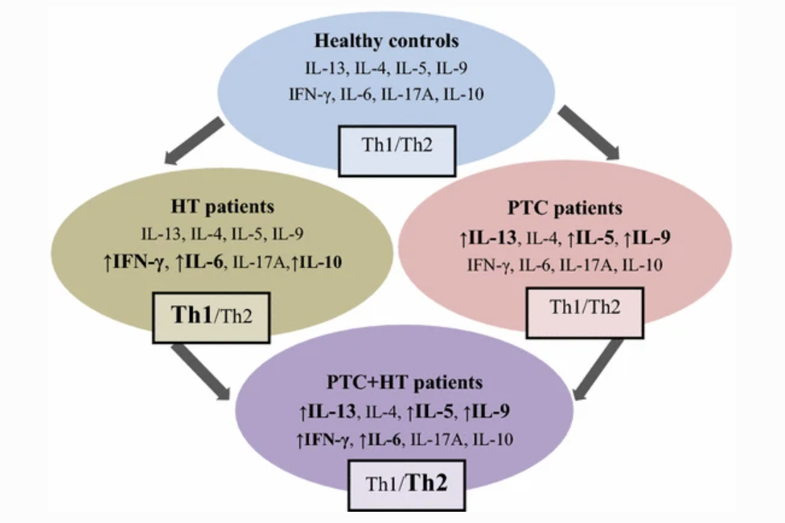
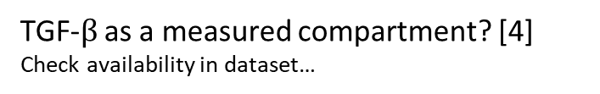
To include?
Potential T3/T4 action on immune cells [2]
TGF-$β$ as a measured compartment? [4]
Check availability in dataset…
Cytokine elevation in HT [5]

Slide 11
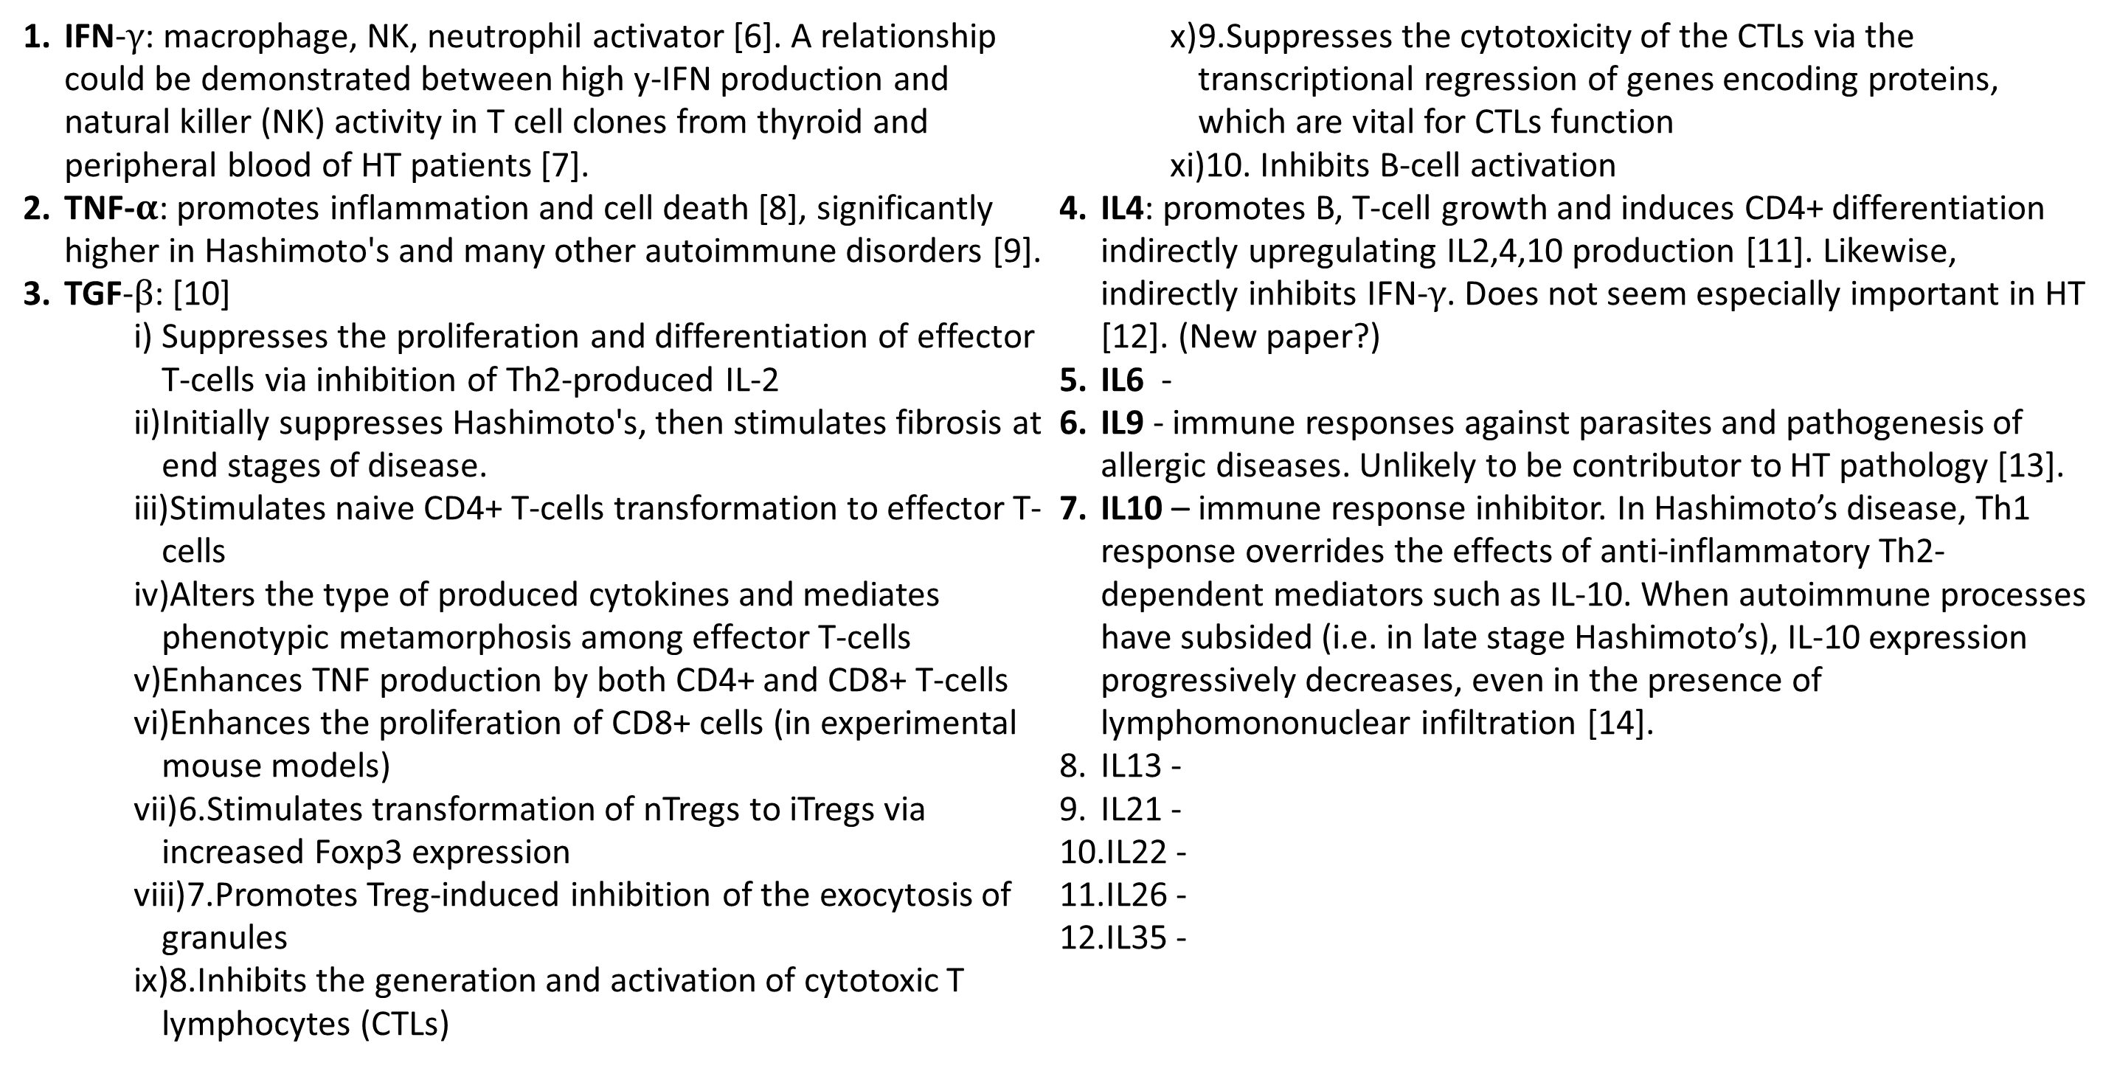
Cytokine Action Summary
IFN-$γ$: macrophage, NK, neutrophil activator [6]. A relationship could be demonstrated between high y-IFN production and natural killer (NK) activity in T cell clones from thyroid and peripheral blood of HT patients [7].
TNF-$α$: promotes inflammation and cell death [8], significantly higher in Hashimoto's and many other autoimmune disorders [9].
TGF-$β$: [10]
Suppresses the proliferation and differentiation of effector T-cells via inhibition of Th2-produced IL-2
Initially suppresses Hashimoto's, then stimulates fibrosis at end stages of disease.
Stimulates naive CD4+ T-cells transformation to effector T-cells
Alters the type of produced cytokines and mediates phenotypic metamorphosis among effector T-cells
Enhances TNF production by both CD4+ and CD8+ T-cells
Enhances the proliferation of CD8+ cells (in experimental mouse models)
6.Stimulates transformation of nTregs to iTregs via increased Foxp3 expression
7.Promotes Treg-induced inhibition of the exocytosis of granules
8.Inhibits the generation and activation of cytotoxic T lymphocytes (CTLs)
9.Suppresses the cytotoxicity of the CTLs via the transcriptional regression of genes encoding proteins, which are vital for CTLs function
10. Inhibits B-cell activation
IL4: promotes B, T-cell growth and induces CD4+ differentiation indirectly upregulating IL2,4,10 production [11]. Likewise, indirectly inhibits IFN-$γ$. Does not seem especially important in HT [12]. (New paper?)
IL6 -
IL9 - immune responses against parasites and pathogenesis of allergic diseases. Unlikely to be contributor to HT pathology [13].
IL10 – immune response inhibitor. In Hashimoto’s disease, Th1 response overrides the effects of anti-inflammatory Th2-dependent mediators such as IL-10. When autoimmune processes have subsided (i.e. in late stage Hashimoto’s), IL-10 expression progressively decreases, even in the presence of lymphomononuclear infiltration [14].
IL13 -
IL21 -
IL22 -
IL26 -
IL35 -

Slide 12
References
[1] Ralli, Massimo et al. “Hashimoto's thyroiditis: An update on pathogenic mechanisms, diagnostic protocols, therapeutic strategies, and potential malignant transformation.” Autoimmunity reviews vol. 19,10 (2020): 102649. doi:10.1016/j.autrev.2020.102649
[2] Wenzek, Christina et al. “The interplay of thyroid hormones and the immune system - where we stand and why we need to know about it.” European journal of endocrinology vol. 186,5 R65-R77. 23 Mar. 2022, doi:10.1530/EJE-21-1171
[3] Image from Chapter 49, "Synthesis of Thyroid Hormones" in: Walter F. Boron; Emile L. Boulpaep (2012). Medical Physiology (2nd ed.). Elsevier/Saunders.
[4] - Kardalas E, Maraka S, Papagianni M, Paltoglou G, Siristatidis C, Mastorakos G. TGF-β Physiology as a Novel Therapeutic Target Regarding Autoimmune Thyroid Diseases: Where Do We Stand and What to Expect. Medicina (Kaunas). 2021 Jun 14;57(6):621. doi: 10.3390/medicina57060621. PMID: 34198624; PMCID: PMC8232149.
[5] Zivancevic-Simonovic, S., Mihaljevic, O., Majstorovic, I. et al. Cytokine production in patients with papillary thyroid cancer and associated autoimmune Hashimoto thyroiditis. Cancer Immunol Immunother 64, 1011–1019 (2015). https://doi.org/10.1007/s00262-015-1705-5
[6] Tau G, Rothman P. Biologic functions of the IFN-gamma receptors. Allergy. 1999 Dec;54(12):1233-51. doi: 10.1034/j.1398-9995.1999.00099.x. PMID: 10688427; PMCID: PMC4154595.
[7] Del Prete GF, Tiri A, Mariotti S, Pinchera M, Rici M, Romagnani S. Enhanced production of IFNγ by thyroid-derived T cell clones from patients with Hashimoto's thyroiditis. Clin Exp Immunol. 1987;69:323–31.
[8] Jang DI, Lee AH, Shin HY, Song HR, Park JH, Kang TB, Lee SR, Yang SH. The Role of Tumor Necrosis Factor Alpha (TNF-α) in Autoimmune Disease and Current TNF-α Inhibitors in Therapeutics. Int J Mol Sci. 2021 Mar 8;22(5):2719. doi: 10.3390/ijms22052719. PMID: 33800290; PMCID: PMC7962638.
[9] Díez, Juan J et al. “Serum concentrations of tumour necrosis factor-alpha (TNF-alpha) and soluble TNF-alpha receptor p55 in patients with hypothyroidism and hyperthyroidism before and after normalization of thyroid function.” Clinical endocrinology vol. 57,4 (2002): 515-21. doi:10.1046/j.1365-2265.2002.01629.x
[10] Kardalas E, Maraka S, Papagianni M, Paltoglou G, Siristatidis C, Mastorakos G. TGF-β Physiology as a Novel Therapeutic Target Regarding Autoimmune Thyroid Diseases: Where Do We Stand and What to Expect. Medicina (Kaunas). 2021 Jun 14;57(6):621. doi: 10.3390/medicina57060621. PMID: 34198624; PMCID: PMC8232149.
[11] Stephen T. Smiley, Michael J. Grusby, in Encyclopedia of Immunology (Second Edition), 1998
[12] Bossowski, A., Harasymczuk, J., Moniuszko, A. et al. Cytometric evaluation of intracellular IFN-γ and IL-4 levels in thyroid follicular cells from patients with autoimmune thyroid diseases. Thyroid Res 4, 13 (2011). https://doi.org/10.1186/1756-6614-4-13
[13] Rojas-Zuleta, Wilmer Gerardo, and Elizabeth Sanchez. “IL-9: Function, Sources, and Detection.” Methods in molecular biology (Clifton, N.J.) vol. 1585 (2017): 21-35. doi:10.1007/978-1-4939-6877-0_2
[14] de la Vega JR, Vilaplana JC, Biro A, Hammond L, Bottazzo GF, Mirakian R. IL-10 expression in thyroid glands: protective or harmful role against thyroid autoimmunity? Clin Exp Immunol. 1998 Jul;113(1):126-35. doi: 10.1046/j.1365-2249.1998.00628.x. PMID: 9697995; PMCID: PMC1905025.

Slide 13
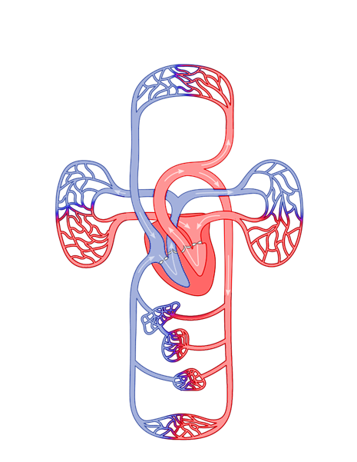

Immune-Thyroid Model:
Normal Function
Plasma Cell
T3
T4
Anti-pathogen antibodies
T3
B-Cell
TRH
Deiodinases
Pathogen Apoptosis
Hypothalamus
T4
Pituitary
T4
T4
T3
TSH
T3
Thyroid
TSH
TGF-$β$
IL-10,35
Deiodinases
IL-4,13
IL-21,4
T4
T4
T4
Slow
IL-9,10
Treg
Tfh
T3
T3
Th2
IL-21,22,26
Th9
T4
Dendritic Cell
or other APC
Dendritic Cell
or other APC
T3
T3
Th17
Pathogen
IL-22
TNF-a
Pathogenic Antigens
Deiodinases
CD4+ T-Cell
Fast
T4
Th22
IFN-$γ$
Cytokines
Th1
Notes:
Add slide with destruction of thyroid → resulting dynamics via T3/4 TSH graphs
Distinguish stimulatory/inhibitory cytokines
Dendritic cytokines?
CD8+ go into cell diagram (perforins and granzyme MOA)
Thyroid in fast compartment
Morph slides to show compartmentalization process
Separate (duplicate) set of slides with superscript references

Slide 14

Immune-Thyroid Model:
Hashimoto’s
Thyroiditis
T3
T4
Plasma Cell
Cytokines
TGAb
T3
B-Cell
TRH
Follicle Colloid
Deiodinases
TPOAb
TG
T4
T4
TPO
T4
T3
Cell Death
TSH
T3
Thyroid
TSH
TGF-$β$
IL-10,35
Deiodinases
IL-4,13
IL-21,4
T4
T4
Thyroid Antigen
T4
Slow
IL-9,10
Treg
Tfh
T3
T3
Th2
TLR2/3
IL-21,22,26
Th9
T4
Dendritic Cell
or other APC
T3
T3
Th17
IL-22
TNF-a
Deiodinases
CD4+ T-Cell
Fast
T4
Th22
IFN-$γ$
Cytokines
Th1
Notes:
Add slide with destruction of thyroid → resulting dynamics via T3/4 TSH graphs
Distinguish stimulatory/inhibitory cytokines
Dendritic cytokines?
CD8+ go into cell diagram (perforins and granzyme MOA)
Thyroid in fast compartment
Morph slides to show compartmentalization process
Separate (duplicate) set of slides with superscript references

Slide 15
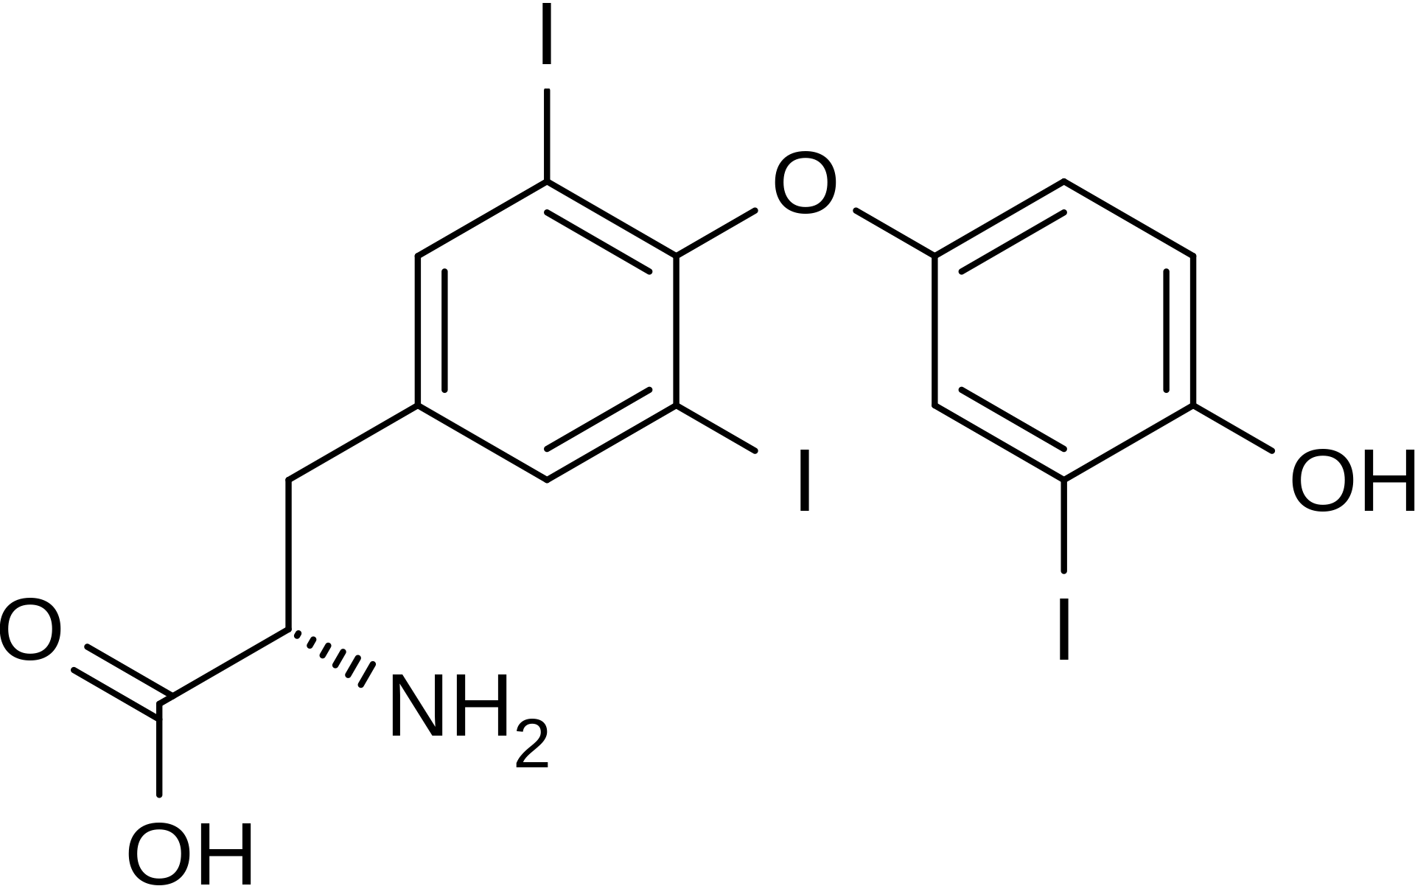
T3
TRH
Deiodinases
T4
T4
T3
T3
TSH
TSH
Deiodinases
T4
Slow
T4
Thyroid
T4
T3
T3
T4
T3
T3
Deiodinases
Fast
T4
Notes:
Add slide with destruction of thyroid → resulting dynamics via T3/4 TSH graphs
Distinguish stimulatory/inhibitory cytokines
Dendritic cytokines?
CD8+ go into cell diagram (perforins and granzyme MOA)
Thyroid in fast compartment
Morph slides to show compartmentalization process
Separate (duplicate) set of slides with superscript references

